Slide 1

Acknowledgment of Traditional Owners
I acknowledge the Turrbal & Yugara as the First Nations owners of the lands where QUT now stands.
I pay respect to their Elders, lores, customs & creation spirits. I recognise that these lands have always been places of teaching, research & learning.
QUT acknowledges the important role Aboriginal & Torres Strait Islander people play within the QUT community.
0

Slide 2

The promise and pitfalls of data sharing:
A case study of Australia’s COVID-19 response
Dr Bernadette Hyland-Wood
Centre for Data Science &
Digital Media Research Centre
Queensland University of Technology
2

Slide 3
Agenda
Preamble – A career in data science punctuated by global crises
Relevance of public data & this study
The research problem
Conceptualising data ecosystems
Methods
Research questions
Analysis & Findings
Our responsibility as data scientists…
3

Slide 4


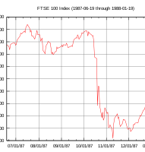

A career in data science punctuated by global crises
4

Slide 5
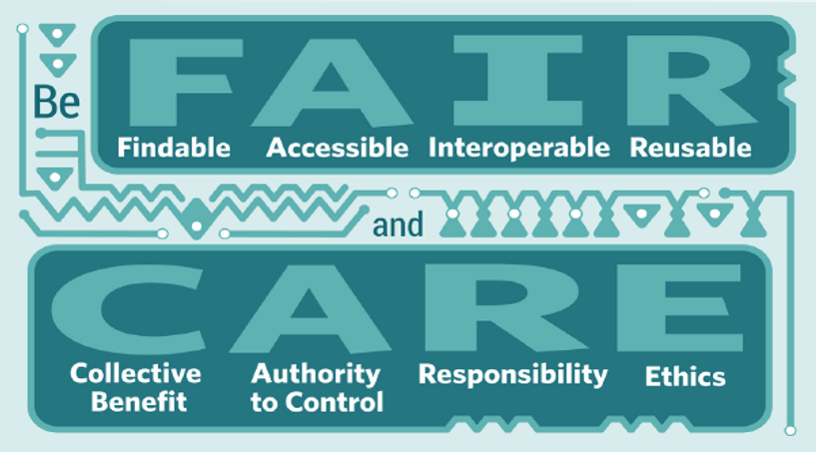
Data availability & use
Enterprise data sharing (1990s)
Information sharing via the Web (2000s)
Human & machine-readable data (2008-present)
Open government data
Public health data
Indigenous data governance
5

Slide 6
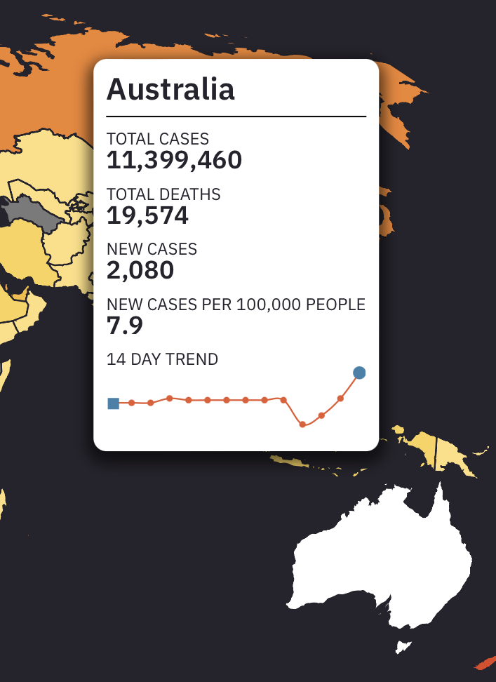
1. Relevance of public data supply
Data is indispensable to policy-making
Many factors shape data production, sharing & analysis
Data access is essential
Data is ephemeral
Data has policy & political dimensions
WHO Investigation into the origins of COVID-19
NB: The international community was given access to the metagenomic data in March 2023. Once the significance of the data was understood, it was quickly removed. See 20-Mar 2023 pre-print
6
Credit: Information is Beautiful Univers Labs Nueker. Data Johns Hopkins University as of 6-Apr 2023

Slide 7
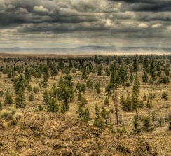
2. The research problem
Insufficient theoretical and empirical examination of public data supply.
We offer a new, radically decentred approach to data used for complex modelling
Based on the experience of experts who needed access to public data during a prolonged crisis
Focuses on a data ecosystems approach
7

Slide 8

Decentred
Definition: Displaced from the centre or a central position; Remove or displace from a primary place or central role.
-Oxford Dictionary
Relevant to
Data sharing among healthcare & systems modelers, especially during crises
National Agreement on Closing the Gap, Priority Reform Four – Shared Access to Data and Information at a Regional Level
Target: Increase the number of regional data projects to support Aboriginal and Torres Strait Islander communities to make decisions about Closing the Gap and their development.
Image credit: https://www.closingthegap.gov.au/national-agreement/priority-reforms
8

Slide 9
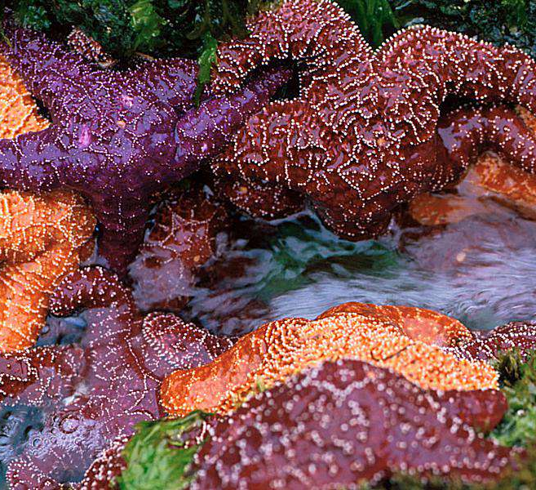
3. Conceptualizing data ecosystems
The ecosystem metaphor for understanding complex relationships in business & society.
Data ecosystems are complex, mutually interdependent information-sharing arrangements.
Keystone actors are crucial to the survival of ecosystems.
9

Slide 10
Movement | First | Second | Third
Dominant organisational forms | Communities, iron triangles | Networks, quasi-markets, advocacy coalitions | Ecosystems
Locus of control | Centralised | Polycentric | Decentred
Leadership | Authority (formal and informal) | Meta-governance, orchestration, contractualism (principal/agent) | Keystones
Mobilising mechanism | Institutional leadership and rules | Collaboration and inducement | Seeding and feeding
Form of interdependence | Hierarchical/vertical | Interactional/horizontal/ contractual | Radical/multidirectional
Objectives | Coherence and stability | Flexibility, inclusion and responsiveness, instrumental value | Ecosystem services: provision, regulation, support, culture
Table 1: Three movements towards decentred policy action – (Howard & Hyland-Wood, forthcoming, 2023)
10

Slide 11

Three lenses on data ecosystems
Organic adaptation: Emerge without the need for a central plan, mandate or explicit authorization.
Institutional leadership: Affords management & governance in shaping boundaries & frameworks.
Instrumental responsiveness: Provides specific value to policy principals, such as evidence for policy decision-making.
11

Slide 12

4. Methods -
Our empirical study
Qualitative study
In-depth case study of Australia’s infectious disease data ecosystem
Interviews with research & healthcare delivery experts
Highly salient to community & political representatives.
12

Slide 13

5. Research questions
What is the relationship between data ecosystems & older, more established modes of policy action?
How do data ecosystems operate under different conditions -- policy equilibrium vs shock?
Do data ecosystems experience tensions, and if so, how can these be managed?
13

Slide 14
“ The whole organisation was behind getting this out. Everyone felt like they were part of doing the community good (CE-11, Public Data Custodian).
“ Slow, tedious, frustrating, expensive, and resource intensive. So, look, we've had the privilege of access to data for a very long time. But the access is inefficient [and] resource intensive (CE-18, Epidemiologist).
“ I think health departments, at least [in my state], and our experience with the Commonwealth Health [Department], is that it was just a nightmare getting data out of them (CE-10, Modeler).
“ Part of the failure in the system at the moment, and it was just brought into sharp focus with the pandemic, it's no one's job to provide data access. People do it on top of their existing jobs. So they do it out of goodwill (CE-18, Epidemiologist).
Responses were
varied but telling
14

Slide 15
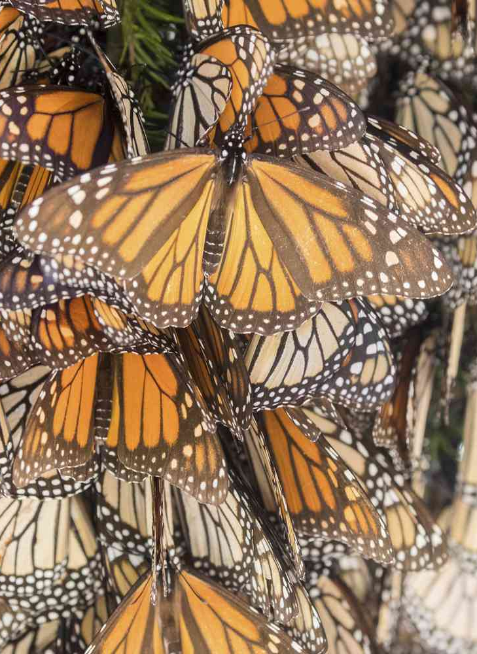
6. Analysis & findings
COVID-19 placed unprecedented demands on the public health field in all jurisdictions.
Data sharing on infectious diseases improved during the pandemic.
Longstanding barriers were reduced or eliminated for some.
Data access approvals were expedited, as was funding.
However, others experienced ongoing problems.
Data sharing practices have not been codified for future crisis response
15

Slide 16
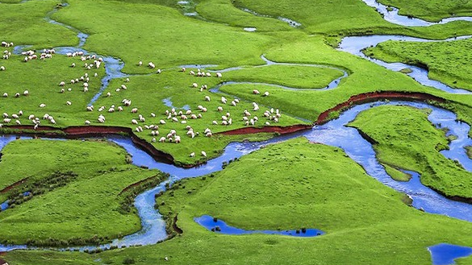
Contribution
Data ecosystem framework displays organic adaptation, institutional leadership, and instrumental utility.
There is a conceptual difference between ecosystems & (older) forms of policy action.
The empirical analysis found a radical dependence within ecosystems on a small group of ‘keystones.’
Role of ‘seeding & feeding’ the ecosystem with fertile material, including data & funding.
Government agencies can either enable or severely constrain actors in carrying out their policy advisory functions.
16

Slide 17

Forthcoming
The promise and performance of data ecosystems: A case study of infectious disease modelling and Australia’s COVID-19 response (Howard & Hyland-Wood, 2023)
Under review for a special issue on the Architectures of Knowledge Exchange Uncovered in Times of Crises
Editors Marleen Easton (Ghent University, Belgium), Peter Aagaard (Roskilde University, Denmark), and Brian Head (University of Queensland, Australia)
17

Slide 18

Take aways from today
Never waste a ‘good’ crisis
Step up & contribute as you can
Learn the lessons & codify them
Recognise your superpowers as a data scientist, researcher or data custodian
Build trust & act in the public interest
18

Slide 19

Thank you!
Dr Bernadette Hyland-Wood
b.hylandwood@qut.edu.au
A/Prof Cosmo Howard
c.howard@griffith.edu.au

