Slide 1

The Role of Solidarity in Addressing Climate Injustice
Public Lecture, Queensland University of Technology
Wednesday, 30 July 2025
The Hon. Justice Brian Preston AO FRSN SC
Chief Judge of the Land and Environment Court of New South Wales

Slide 2
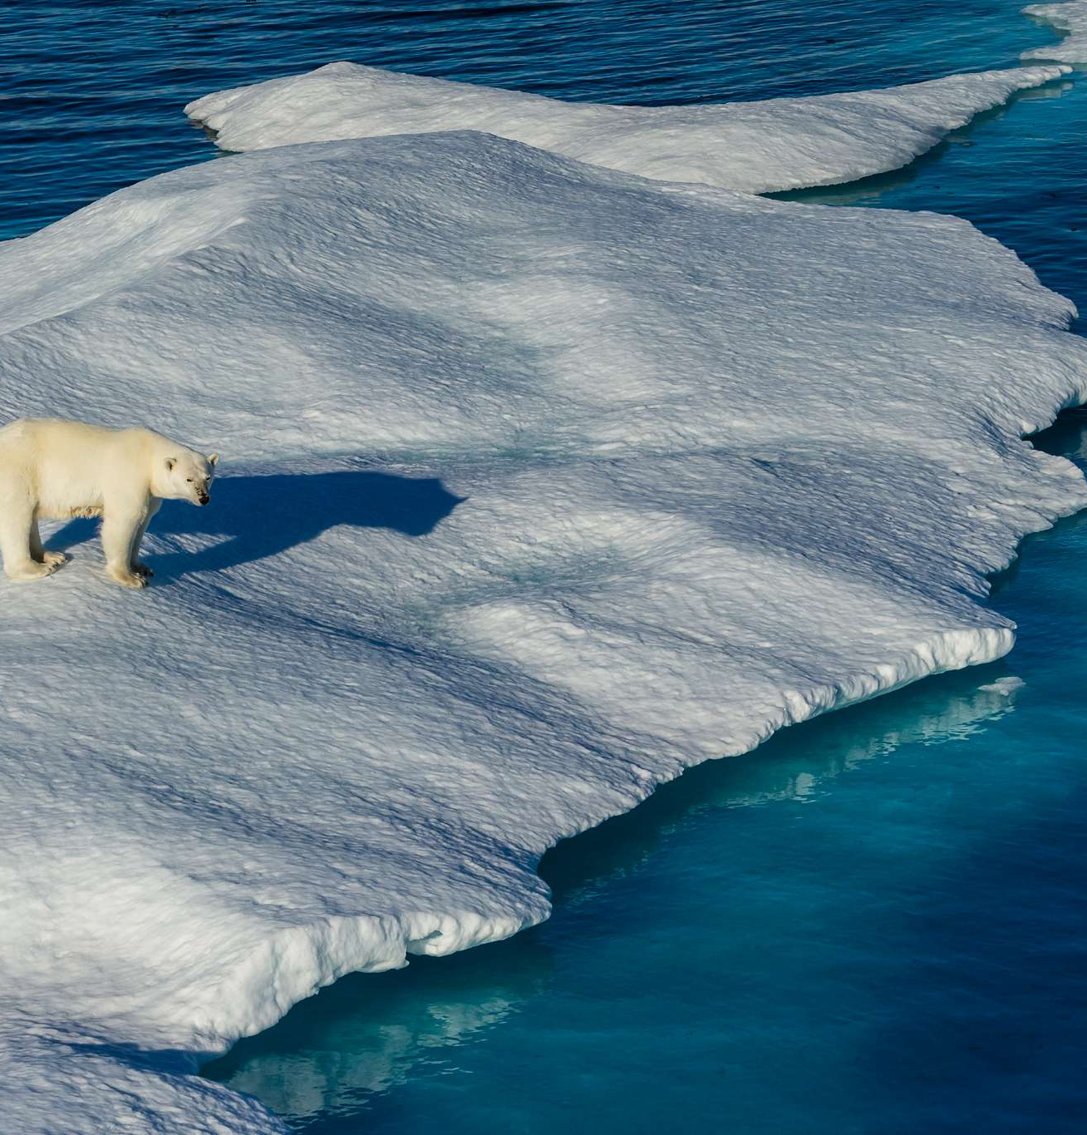
Solidarity and Climate Injustice
Overview
What is solidarity?
Ten manifestations of solidarity in international climate law
Six manifestations most relevant to climate injustice:
  Solidarity in action;
  Solidarity in leadership;
  Solidarity in achieving fair shares;
  Solidarity in support;
  Intragenerational solidarity; and
  Intergenerational solidarity.
  From climate injustice to climate justice

Slide 3
What is solidarity?
The need for solidarity
Solidarity as a legal norm
Earth is facing a triple planetary crises of climate change, pollution and biodiversity loss.
The consequences of climate change are manifest today: increased temperatures, intensity and severity of droughts, water scarcity, wildfires, rising sea levels, flooding, melting polar ice, catastrophic storms and declining biodiversity.
Climate change is a justice problem, as the exploitation of the world’s fossil fuel reserves by the richest countries (the developed countries) has enabled them to enjoy economic prosperity, however, countries that have contributed the least to the climate change crisis suffer the most from climate change and are less able to afford costly adaptation measures.
Solidarity is a foundational concept of international law that has developed into a norm with legal implications.
Solidarity directs and mandates a certain conduct of states, and non-state actors, in order to avert and redress the deterioration of living conditions of human and non-human life on the planet.
Solidarity has the capacity to address climate injustice because it provides guidance for decision-making under the normative demands and objectives of international climate law.
As a norm for decision-making, solidarity requires, at a minimum, alignment of states’ own conduct with that of others in the pursuit of a common objective, even if that entails a sacrifice.

Slide 4
Ten manifestations of solidarity in the international climate law regime
Solidarity in action
Solidarity in leadership
Solidarity in achieving fair shares
Solidarity amongst peers
Solidarity in support
Intragenerational solidarity
Intergenerational solidarity
Solidarity with nature
Solidarity in science
Inter-jurisdictional juristic solidarity
Six of these manifestations, shown in bold, are especially concerned with equity and justice.

Slide 5

Solidarity in action

Slide 6
All countries need to take action to mitigate climate change
UNFCCC
Paris Agreement
6th Recital: “the global nature of climate change calls for the widest possible cooperation by all countries and their participation in an effective and appropriate response, in accordance with their common but differentiated responsibilities and respective capabilities and their social and economic conditions.”
Art 3: Recognises that all parties have common responsibilities to take mitigation action.
Arts 2 and 4: All parties to take measures to reduce GHG emissions in their jurisdictions to keep the increase in global average temperatures to well below 2°C, ideally close to 1.5°C, above pre-industrial levels by 2050.
Art 4: All parties to submit NDCs to self-determine their emissions reduction measures with a requirement for each NDC to be a progression beyond the current NDC and reflect the highest possible ambition.

Slide 7

Solidarity in leadership

Slide 8
Developed countries have increased responsibilities and capabilities to take the lead in GHG emissions reductions
UNFCCC
18th Recital: “the need for developed countries to take immediate action in a flexible manner on the basis of clear priorities, as a first step towards comprehensive response strategies at the global, national and, where agreed, regional levels that take into account all greenhouse gases, with due consideration of their relative contributions to the enhancement of the greenhouse effect”
Art 3(1): “the developed country Parties should take the lead in combating climate change and the adverse effects thereof.”
Art 4(2)(a): each developed country party and other party included in Annex I required to “adopt national policies and take corresponding measures on the mitigation of climate change, by limiting its anthropogenic emissions of greenhouse gases and protecting and enhancing its greenhouse gas sinks and reservoirs”, so as to “demonstrate that developed countries are taking the lead in modifying longer-term trends in anthropogenic emissions consistent with the objective of the Convention…”.

Slide 9
Developed countries have increased responsibilities and capabilities to take the lead in GHG emissions reductions
Kyoto Protocol
The top-down approach of the Kyoto Protocol imposed obligations on developed country parties and other parties in Annex I to the UNFCCC to take prescribed mitigation action
Art 3: These countries were to achieve the quantified emissions reduction commitments prescribed in Annex B of the Kyoto Protocol.
Art 10: Non-Annex I countries did not have prescribed commitments, although they were encouraged to formulate and implement their own, self-determined efforts to mitigate anthropogenic emissions by sources and removals by sinks of GHG emission.

Slide 10
Developed countries have increased responsibilities and capabilities to take the lead in GHG emissions reductions
Paris Agreement
Art 4(4): “Developed country Parties should continue taking the lead by undertaking economy-wide absolute emission reduction targets. Developing country Parties should continue enhancing their mitigation efforts and are encouraged to move more over time towards economy-wide emission reduction or limitation targets in the light of different national circumstances.”
Art 9(3): Calls for developed parties to take the lead in mobilizing climate finance from a wide variety of sources, taking into account the needs and priorities of developing countries.

Slide 11
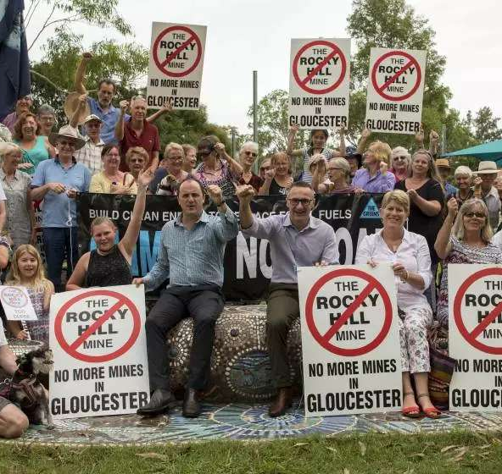
Case example: Gloucester Resources Limited v Minister for Planning
The Land and Environment Court of New South Wales, Australia, dismissed an appeal brought by a coal mine company against a refusal by the Minister for Planning for development consent to allow a new coal mine to go ahead.
In doing so, the Court held that developed countries, such as Australia, have a responsibility “to take the lead in taking mitigation measures to reduce GHG emissions”.
One way of taking the lead is by developed countries refusing a new development for the exploitation or burning of fossil fuel reserves, such as a coal mine.
Developing countries may be encouraged likewise not to approve new development for the exploitation or burning of fossil fuel reserves by developed countries taking the lead in doing so in their countries.
See Gloucester Resources Limited v Minister for Planning (2019) 234 LGERA 257 at [539]-[540].
Image source: Gloucester Advocate

Slide 12

Solidarity in achieving fair shares

Slide 13
Countries have different responsibilities, capabilities and national circumstances and need to contribute fairly to global climate change efforts
UNFCCC
Paris Agreement
3rd Recital: Notes that that “the largest share of historical and current global emissions of greenhouse gases has originated in developed countries”.
18th Recital: Recognises “the need for developed countries to take immediate action in a flexible manner on the basis of clear priorities, as a first step towards comprehensive response strategies at the global, national and, where agreed, regional levels that take into account all greenhouse gases, with due consideration of their relative contributions to the enhancement of the greenhouse effect”.
Art 4(4): “Developing country Parties should continue enhancing their mitigation efforts and are encouraged to move more over time towards economy-wide emission reduction or limitation targets in the light of different national circumstances.”

Slide 14
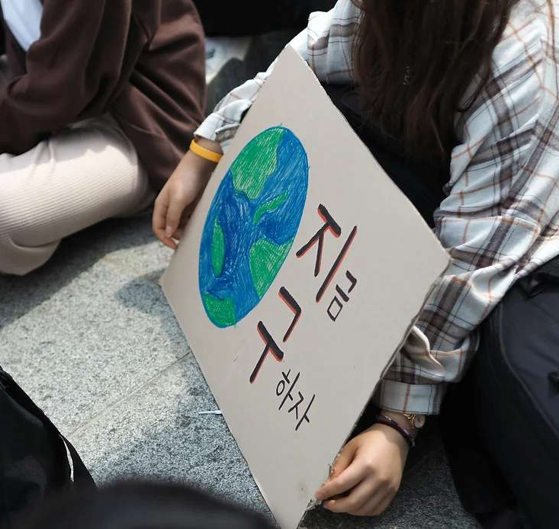
Case example: Do-Hyun Kim v South Korea
Youth activists brought a case to the South Korean Constitutional Court, alleging the state’s climate change law violated their fundamental rights including the right to a clean environment.
The law commits South Korea to reduce its GHG emissions by 24% by 2030, from 2017 levels.
In August 2024, the Constitutional Court unanimously held that the law violated the right to a healthy environment and ordered the National Assembly to amend the law by 28 February 2026.
The Court held that South Korea was obliged to bear its fair share of responsibility for global greenhouse gas emissions reduction obligations, assessed based on science and international standards.
See Constitutional Court of Korea, Decision in cases 2020HunMa389; 2021HunMa1264 (Consolidated); 2022HunMa854 (Consolidated); and 2023HunMa846 (Consolidated), 29 August 2024 (unofficial English translation prepared by Plan 1.5).
Image source: Climate Court

Slide 15

Solidarity in support

Slide 16
The increased responsibilities and capabilities of developed countries triggers these countries to provide support to developing countries
UNFCCC
Encourages support ranging from the general, such as promoting economic growth to enable developing countries to better address the problems of climate change, to the specific, such as promoting research, exchange of information and transfer of technology with respect to scientific, technological, technical, socio-economic, legal and other matters.
Art 4(3): Commits developed countries and other parties included in Annex I to provide financial resources to developing countries to meet their costs in meeting their commitments under Article 4(1) and Article 12(1).
Art 4(4): Commits developing countries that are particularly vulnerable to the adverse effects of climate change in meeting costs of adaptation to those adverse effects. The UNFCCC established a mechanism for the provision of financial resources, on a grant or concessional basis, including for the transfer of technology.

Slide 17
The increased responsibilities and capabilities of developed countries triggers these countries to provide support to developing countries
Kyoto Protocol
Committed or encouraged developed countries and other parties included in Annex I to the UNFCCC to:
  Art 2(1): share with developing countries their experience and to exchange information on policies and measures on the mitigation of climate change and the transition to renewable forms of energy, amongst other matters;
  Art 10(c): promote, facilitate and finance the transfer of, or access to, environmentally sound technologies, know-how, practices and processes pertinent to climate change to developing countries;
  Art 10(d): cooperate in scientific and technical research on climate change and its adverse effects;
  Art 10(e): strengthen national capacity-building in developing countries.
Art 11: Committed developed countries and other parties included in Annex I to the UNFCCC to provide financial resources to meet the costs of developing countries in meeting their commitments under the UNFCCC.
Art 12: Established the clean development mechanism, one of the purposes of which was to assist parties not included in Annex I to the UNFCCC in achieving sustainable development and in contributing to the ultimate objective of the UNFCCC.

Slide 18
The increased responsibilities and capabilities of developed countries triggers these countries to provide support to developing countries
Paris Agreement
Art 4(5): Requires support to be provided, in accordance with Articles 9, 10 and 11, to developing countries to assist them in implementing Art 4 regarding preparation and implementation of their NDCs, recognising that enhanced support for developing countries will allow for higher ambition in their mitigation actions.
Art 9: Requires developed countries to provide financial resources to assist developing countries with respect to both mitigation and adaptation, recognising that this is a continuation of developed countries’ existing obligations under the UNFCCC.
Art 10: Encourages technology development and transfer to improve resilience to climate change and to reduce greenhouse gas emissions.
Art 11: States that capacity-building under the Paris Agreement should “enhance the capacity and ability of developing country Parties, in particular countries with the least capacity, such as the least developed countries, and those that are particularly vulnerable to the adverse effects of climate change, such as small island developing States, to take effective climate change action”.

Slide 19
The increased responsibilities and capabilities of developed countries triggers these countries to provide support to developing countries.
Recent COP outcomes
COP29: Climate finance goal
Solidarity in support is demonstrated by commitments of parties to provide financial support for developing countries for climate action. At COP29 in November 2024 in Baku, Azerbaijan, the parties agreed to set a goal of “at least USD 300 billion per year by 2035 for developing country Parties for climate action”.
Developed countries are required to take the lead on this, however the decision iterates that the finance is to come from “a wide variety of sources, public and private, bilateral and multilateral, including alternative sources”.
COP27 and COP 28: Loss and damage funding
Solidarity in support is further illustrated by the ‘breakthrough agreement’ that was made at the close of COP27 to provide loss and damage funding to countries most vulnerable to the effects of climate change.
That initiative of support was formalised at COP28, with an agreement to establish a loss and damage fund to help developing countries cope with the effects of climate change.

Slide 20

Intragenerational solidarity

Slide 21
Those who are able have increased responsibilities to support those who are less able to do so and who are most vulnerable to climate change
UNFCCC
18th Recital: Recognises that “low-lying and other small island countries, countries with low-lying coastal, arid and semi-arid areas or areas liable to floods, drought and desertification, and developing countries with fragile mountainous ecosystems are particularly vulnerable to the adverse effects of climate change.”
Art 3(2): “The specific needs and special circumstances of developing country Parties, especially those that are particularly vulnerable to the adverse effects of climate change, and of those Parties, especially developing country Parties, that would have to bear a disproportionate or abnormal burden under the Convention, should be given full consideration.”
Arts 4(4) and 4(8): Requires developed countries to provide support, in various ways, to developing countries, including assisting those developing countries that are particularly vulnerable to the adverse effects of climate change in taking action, and meeting the costs of such action, to adapt to those adverse effects.

Slide 22
Those who are able have increased responsibilities to support those who are less able to do so and who are most vulnerable to climate change
Paris Agreement
5th, 8th and 9th Recitals: Recognise the specific needs and special circumstances of developing countries, “especially those that are particularly vulnerable to the adverse effects of climate change,” as well as those within these countries suffering poverty and hunger.
11th Recital: When taking action to address climate change, parties should consider their obligations on “human rights, the right to health, the rights of indigenous peoples, local communities, migrants, children, persons with disabilities and people in vulnerable situations and the right to development, as well as gender equality, empowerment of women and intergenerational equity.”
Art 4(15): Requires parties to take into consideration, in the implementation of the Paris Agreement, the concerns of parties with economies most affected by the impacts of response measures, particularly developing countries.
Arts 9, 10 and 11: Provide for developed countries to support, in various ways, developing countries, particularly those vulnerable to the adverse effects of climate change.

Slide 23
Those who are able have increased responsibilities to support those who are less able to do so and who are most vulnerable to climate change
2023 Global Stocktake report
Key Finding 2, regarding strengthening the global response to the threat of climate change, recommended that: “Credible, accountable and transparent actions by non-Party stakeholders are needed to strengthen efforts for systems transformations”.
Key Finding 7 stresses the need for a “just transition” to net zero emissions, in order to “support more robust and equitable mitigation outcomes, with tailored approaches addressing different contexts.” A “just transition” is one that leaves no one behind and is fair for all.

Slide 24
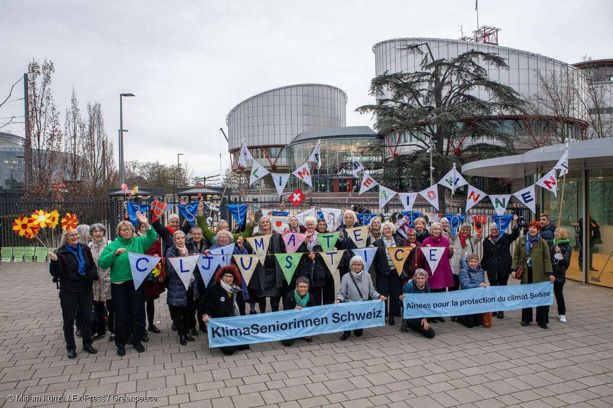
Case example: Verein KlimaSeniorinnen Schweiz and Others v Switzerland
An association of senior women filed a suit against multiple bodies of the Swiss Government, alleging that they had failed to uphold obligations under the Swiss Constitution and European Convention on Human Rights (ECHR) by not steering Switzerland in an emissions reduction trajectory consistent with the goal of keeping global temperatures well below 2ºC.
After having exhausted all national remedies, the petitioners took their claim to the European Court of Human Rights (ECtHR).
The ECtHR found that Art 8 of the ECHR, regarding the right to respect for private and family life, encompasses a right to effective protection for individuals by State authorities from the serious adverse effects of climate change on their lives, wellbeing and quality of life. The State’s duty is to adopt, and apply, regulations and measures capable of mitigating the existing and potentially irreversible, future effects of climate change.
The ECtHR recognised the vulnerability of certain populations to the effects of climate change, such as high temperatures, including older adults, children, women and those with chronic diseases.
The ECtHR also found Switzerland’s insufficiently ambitious GHG emissions reduction targets infringed the human rights of the vulnerable population of older people.
See Verein KlimaSeniorinnen Schweiz and Others v Switzerland, European Court of Human Rights, Grand Chamber, Application No 53600/20, 9 April 2024.
Image source: Miriam Künzli

Slide 25
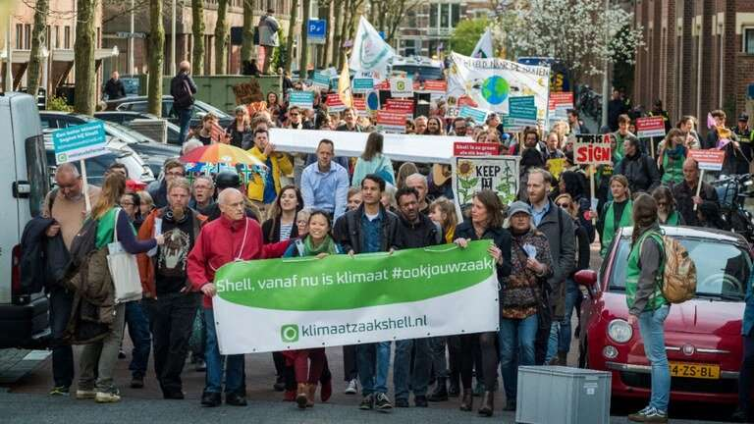
Case example: Milieudefensie et al v Royal Dutch Shell
Milieudefensie/Friends of the Earth Netherlands and six other plaintiffs alleged Royal Dutch Shell (RDS) had violated its duty of care under Dutch law by emitting GHG emissions that contributed to climate change.
The Hague District Court held that RDS does have an obligation to reduce its GHG emissions and ordered RDS to do so by 45% by 2030, compared to 2010 levels, and to net zero by 2050 in line with the Paris Agreement.
Although the specific emissions reduction target was overturned by The Hague Court of Appeal in November 2024, the Court still held that companies, in addition to being required to comply with regulatory obligations, “have a social duty of care to reduce their emissions”.
The Court also recognised that RDS, as “a major oil company … has a special responsibility” and “must make an appropriate contribution to preventing dangerous climate change”.
See Milieudefensie et al v Royal Dutch Shell ECLI:NL:RBDHA:2021:5337, at L4:4:52. and on appeal, ECLI:NL:GHDHA:2024:2100 (The Hague Court of Appeal, 12 November 2024).
Image source: Colombia Undergraduate Law Review

Slide 26

Intergenerational solidarity

Slide 27
The current generation needs to take climate action for the benefit of future generations
UNFCCC
Paris Agreement
11th Recital: Recalls earlier resolutions of the UN General Assembly on the need for the “protection of global climate for present and future generations of mankind”.
23rd Recital: Recites the determination “to protect the climate system for present and future generations”.
Art 3(1): the first of the principles of the UNFCCC is that the parties “should protect the climate system for the benefit of present and future generations of humankind”.
11th Recital: Acknowledges that in taking action to address climate change, consideration needs to be given to “intergenerational equity.”
Arts 2 and 4: The temperature and time targets set by the Paris Agreement have as their purpose the protection of future generations from the adverse effects of climate change. In order to achieve the temperature target in Article 2, the aim is to achieve a balance between anthropogenic emissions by sources and removals by sinks of greenhouse gases in the second half of this century (by 2050).

Slide 28
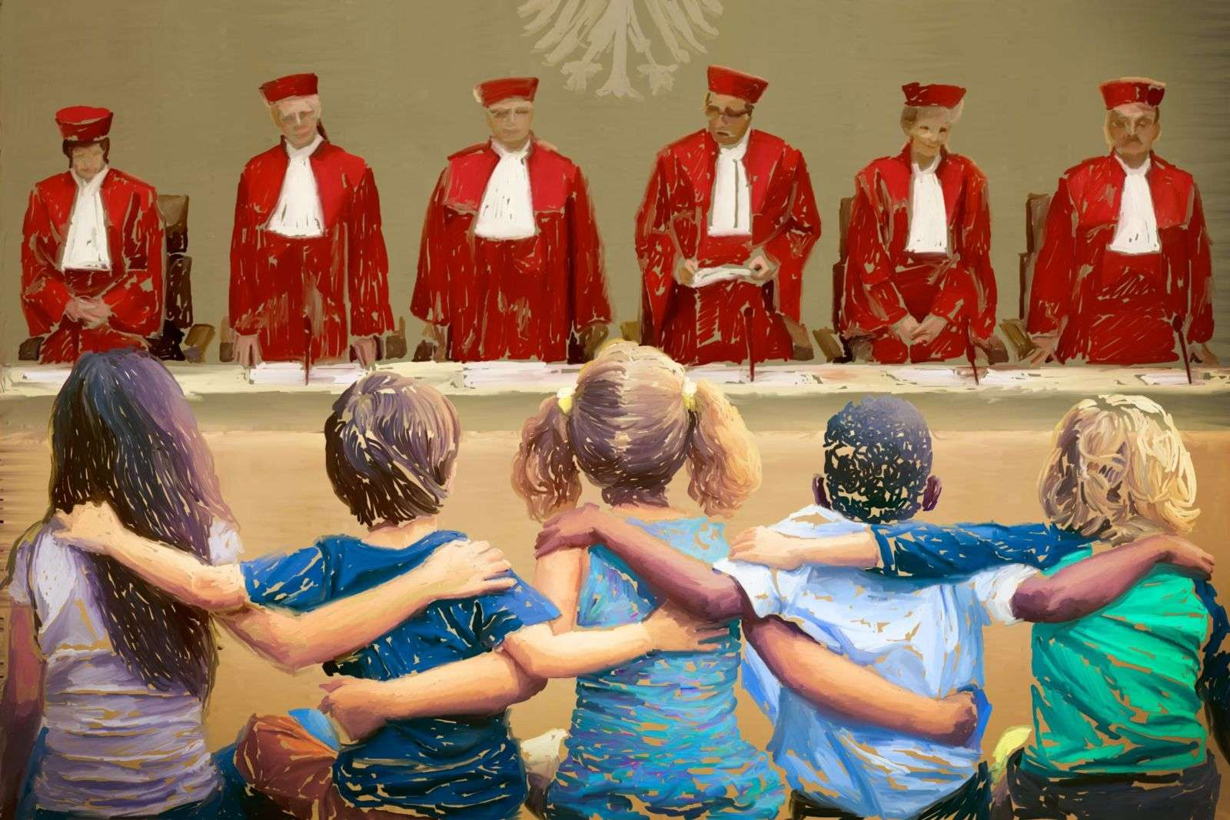
Case example: Neubauer et al v Germany
Germany’s Federal Climate Change Act had set inadequate greenhouse gas emissions reduction targets in the short and mid-term, thereby placing an unreasonable burden on future generations to make even-greater emissions reductions in the future.
The German Federal Constitutional Court held that the Climate Change Act thereby had an “advance interference-like effect” on future freedoms protected by fundamental rights in the German Constitution.
See Neubauer et al v Germany (2021) 1 BvR 2656/18, 1 BvR 78/20, 1 BvR 96/20, 1 BvR 288/20
Image source: Open Global Rights

Slide 29
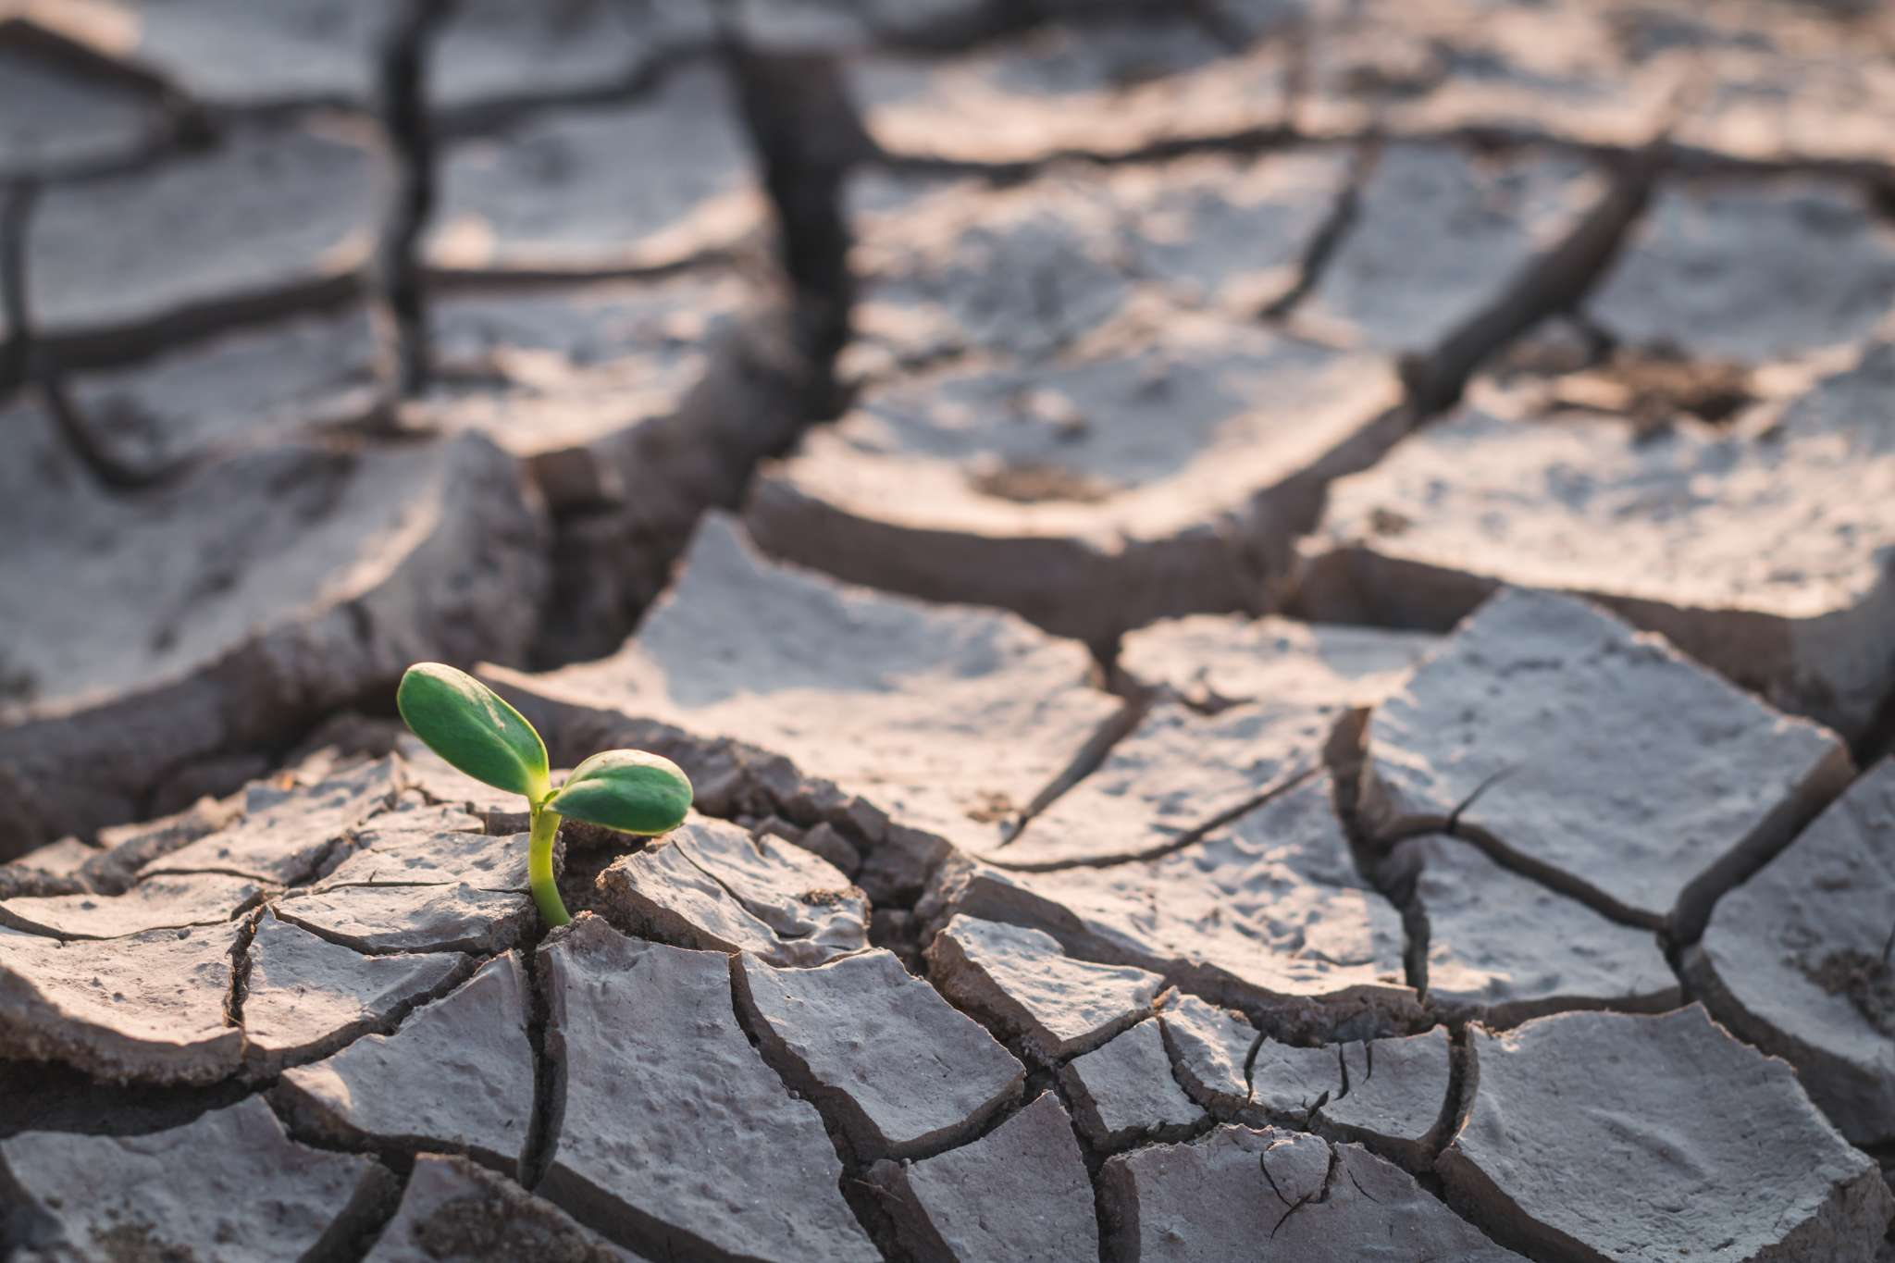
From climate injustice to climate justice
The norm of solidarity assists in driving the mitigation and adaptation efforts needed to address climate change and redress the harm caused by climate change.
It provides a normative framework for policy and decision-making that puts fairness and justice for all at the forefront.
The manifestations of solidarity discussed, which are especially concerned with justice, can structure open-textured, discretionary decision-making, to redress past injustice and achieve future justice.

