Slide 1
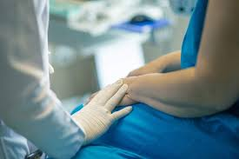
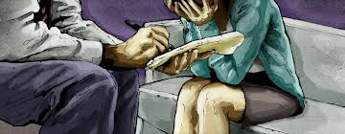
Predation of Doctors by Doctors: Harassment and Sexual Assault in the Workplace
Ian Freckelton AO KC
Barrister, Castan Chambers, Melbourne;
Judge, Supreme Court of Nauru,
Professor of Law & Professorial Fellow in Psychiatry, University of Melbourne;
Honorary Professor of Forensic Medicine,
Monash University
https://ianfreckelton.com.au
I.Freckelton@vicbar.com.au
See L Stone et al (eds), Sexual Harassment Between Doctors (Cambridge Uni Press, open access, 2025, in press)

Slide 2

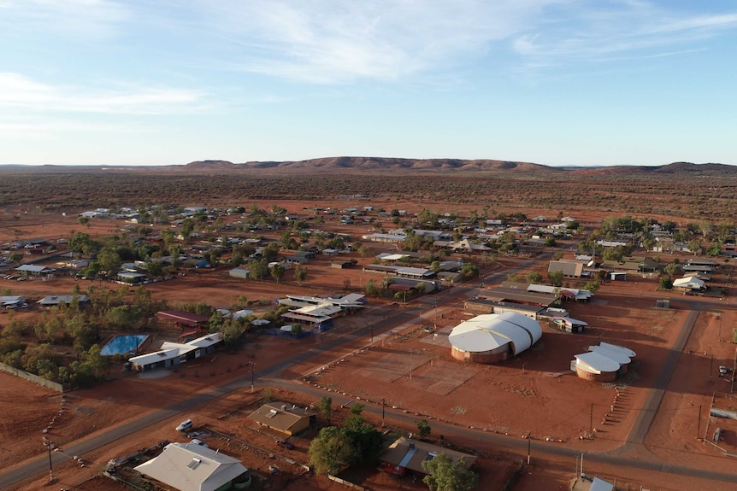

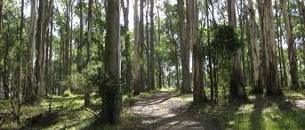
Acknowledgment of Country
I acknowledge the traditional custodians of the unceded lands on which this talk is being delivered, past, present and emerging, and on which all participants in this gathering are residing and visiting.
In particular, I acknowledge the hospitality of the Arrernte Nation of Alice Springs and of the Warlpiri People of Yuendumu with whom I have been working and living for much of the last two years, and the loss they have suffered with the deaths of Kumanjayi Walker and Kumanjayi White.

Slide 3
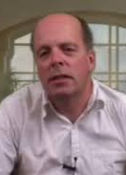
The Conventional Regulatory and Legal Focus
Exercise of power over vulnerable patients
Eg Dr Andrew Churchyard, involving over 100 patients assaulted in the course of his practice as a neurologist
Outcome: Dr Churchyard committed suicide prior to criminal charges, civil actions and disciplinary proceedings reaching completion.
Prof Ron Paterson’s Independent Review of the Use of Chaperones to Protect Patients in Australia
More assertive taking of immediate action and reduced use of chaperones by the 16 Boards

Slide 4
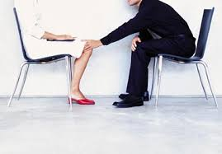
Opportunistic Predation in the Workplace
Occurs in every workplace
Workplaces where there is a hierarchy and vulnerabilities lend themselves to the opportunity for sexual predation and harassment, especially where workplace protections are inadequate

Slide 5


Incidence of Sexual Improprieties
See Haskell et al (2024): bullying, discrimination and harassment
BDH estimated to affect 26.3% of healthcare workers” Lever et al 2019
Clearly a potential for civil liability for employing institutions, for WorkSafe etc and for OHS liability (note recent changes, eg in NSW)
Vic Auditor-General (2016): “consistent failure to hold senior staff to account for inappropriate behaviours and a ‘double standard’ whereby some staff are ‘untouchable’ despite their consistently inappropriate behaviour being common knowledge”

Slide 6

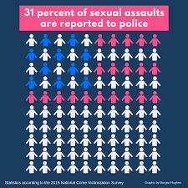
The vast majority of sexual assaults in any context are not reported: 69-95%
Anxieties are influential:
Fear of the investigative process
Fear of court and other processes
Fear of retribution
Concern about not being believed
Worry about being blamed or stigmatised
Self-blame, shock and denial
Cultural considerations, including workplace cultures

Slide 7
Other Reasons for Non-Reporting
Lack of confidence in the investigative and decision-making process: a sense of futility
Concerns about fragile employment status
Awareness of employment and other dangers when perpetrator is organisationally powerful or senior
Expectation of little support, in spite of institutional rhetoric
Detrimental health and social effects
The phenomenon is ubiquitous, disproportionately affecting women

Slide 8
The Phenomena of Sexual Harassment and Assault in the Workplace
BBC 2017 studies: 53% of women suffered work harassment, c10% of those harassed had been assaulted, 9% has been sexually harassed in the previous work year, 63% did not report
Are hospitals likely to be different?

Slide 9
Dr Xenos Litigation
Dr Caroline Tan in 3rd year of training at Monash Medical Centre in 2004
Dr Chris Xenos was a senior neurosurgeon
There was a supportive mentoring relationship
Then Dr X invited Dr T for extra tuition and discussion about neurosurgery topics

Slide 10
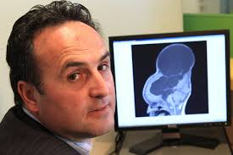
Conduct of Dr Xenos
At early evening meeting, Dr T said Dr X engaged in a series of unwanted acts: kissed her on lips, placed hand on her breast, pinned her to the desk, removed his penis and made explicit sexual proposition
Dr T initially decided not to lodge formal complaint – Dr X was involved in her training assessment and she did not want to be seen as a troublemaker
Dr T confronted Dr X and was told to “move on”

Slide 11
Tan v Xenos (No 3) [2008] VCAT 584
Dr T took action in VCAT alleging sexual harassment in the course of employment, at first only seeking an apology
Dr T was extensively cross-examined and was unable to give evidence about physical characteristics of Dr X’s penis
Dr X called extensive good character evidence
Judge Harbison found Dr T and Dr X to present impressively, although no corroboration to her allegations

Slide 12
Tan v Xenos (No 3) [2008] VCAT 584, Judge Harbison
Dr T’s evidence found to be credible: during far-ranging and repetitive cross-examination she remained consistent, credible and courteous: “she showed extraordinary poise and composure under pressure”
Dr X’s assertion that T’s motive in making complaint was disappointment about adverse performance evaluation rejected that Dr T had deliberately exaggerated

Slide 13
Tan v Xenos (No 3) [2008] VCAT 584, Judge Harbison
“Dr T terribly adversely affected. Her reaction has been unusually severe and, to some extent, out of proportion with the incident itself. She has reacted to it as a gross violation of her body and her trust.”
Dr Xenos “deliberately and falsely denied the harassment’, attempting to smear the character of Dr Tan, exploring every aspect of her professional competence in a context in which neurosurgery is a speciality in Australia with only approximately 150 practitioners.”

Slide 14
Tan v Xenos (No 3) [2008] VCAT 584, Judge Harbison
Dr T failed her final assessment as a neurologist
$100,000 awarded in damages: no appeal
Dr T unable to obtain positions in public and private hospitals
Dr X remained in employment at Monash Health

Slide 15
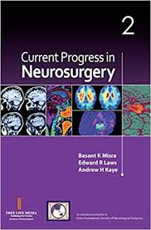
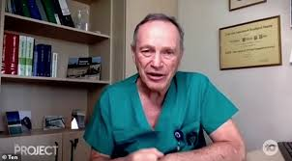
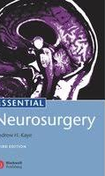
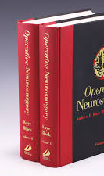
The Andrew Kaye Litigation
Prof Kaye is a world renowned figure in Neurosurgery
1973: Graduated in medicine
1992: Professor of Neurosurgery at RMH
1997: Head of Dept of Surgery at RMH
Former Chair of Board of Examiners
Author of leading Neurosurgery textbooks
Board Member of Hawthorn FC

Slide 16
Medical Board of Australia v Kaye [2025] VCAT 408
Registrar alleged in 2019 Prof K pressured her to drink whisky with him in his rooms with the doors closed, knowing she needed to return to the operating theatre and touched her in a sexualised way
Prof K disputed almost all allegations
Maintained allegations were made after he chastised the registrar for coming to work wearing a backpack, and spoken to a nurse expressing concern about the registrar’s having worn face-piercing jewellery to surgery.
Admitted drinking whisky alone with her in a closed office: conceded to be unwise in retrospect.

Slide 17
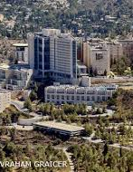
Professor Kaye in Israel
In 2019/2020 Prof K left role at RMH, emigrated to Israel, surrendered registration and became the Hadassah Medical Organization’s Director of Neurosurgery Resident Training, stating that: ‘I wanted to contribute to Israel, andmI felt guilty that I had not done it earlier.’

Slide 18
Medical Board of Australia v Kaye [2025] VCAT 408
Registrar’s account accepted by VCAT
Prof K disbelieved on his oath
‘People process trauma in different ways and it is not necessarily the case that Dr A would remember every detail of the events.’
‘In the context of Dr Kaye being an eminent and influential neurosurgeon, . . . Dr A felt pressured to drink the whisky and did drink the whisky’.

Slide 19
Medical Board of Australia v Kaye [2025] VCAT 408
Comfortable satisfaction’ that Prof Kaye failed to maintain professional boundaries in inviting the junior doctor to his office for a non-clinical or non-academic purpose and that she felt pressures to drink the whisky he offered her.
Comfortably satisfied that he placed his right hand on Dr A’s left leg and hands; attempted to stroke Dr A’s hands; and touched Dr A’s arm, left thigh, hip, back and bottom in the context of Dr Kaye sitting close to Dr A on the couch in his office with the door closed, suggesting to Dr A that she call him Andrew rather than Prof while they were in the office.

Slide 20
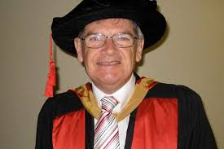
The Kearsley Litigation
Dr K: Professor and Director of Radiation Oncology at the Cancer Care Centre at St George Hospital, Sydney
Dr K pleaded guilty in the NSW District Court to administering Lorazepam to enable him to assault Registrar indecently at a private dinner at his apartment to which she was invited to enable discussions about her career
Registrar was supervised by Dr K

Slide 21
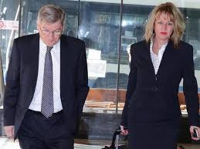
R v Kearsely, unreported, District Court of NSW, 26 August 2016, Hock DCJ
Dr K claimed to be deeply apologetic
Explained that he had been under significant pressure and had experienced alcohol blackouts and would undertake treatment to deal with his problem. He was devastated that he had put her in this predicament and offered any third party assistance he could give her, including counselling and mediation with health professionals for both of them.

Slide 22
R v Kearsely, unreported, District Court of NSW, 26 August 2016, Hock DCJ
Registrar’s victim impact statement:
I suffer constant intrusive thoughts and questions about why I was chosen to be the victim of such a despicable crime’.
I have been had been robbed of my confidence and self-worth and have been treated for two years for posttraumatic stress disorder.

Slide 23
R v Kearsely, unreported, District Court of NSW, 26 August 2016, Hock DCJ
Dr K’s intoxication and psychiatric conditions at the time of the offences provided a context for his conduct, although they did not excuse it, and there was only a tenuous link between his psychiatric conditions and his putting a drug in the Registrar’s drink and his sexually assaulting her.
I accept that Dr K is genuinely remorseful and unlikely to reoffend.
Aggregate sentence of imprisonment of
four years and three months’ imprisonment with a non-parole period of two years and three months.

Slide 24
Kearsley v The Queen [2017] NSWCCA 28: The Appeal
Taking into account that by now Dr K has lost his profession and position of good standing in the community and has been the subject of adverse media publicity with a detrimental effect upon his mental health, the sentencing judge had erred in failing to address explicitly in her reasons the objective gravity of the offence, which in respect of the drugging was ‘moderate’ and in respect of the indecent assault was ‘low to moderate’. The principles of general deterrence are not of particular significance by reason of Dr Kearsley’s psychiatric conditions but his ‘subjective case is very strong.

Slide 25
Kearsley v The Queen [2017] NSWCCA 28
The offences were aggravated by the relationship between Dr K and the Registrar ‘generated by his position as a senior medical practitioner and her position as a junior medical practitioner seeking his professional guidance’.
Dr K’s appeal allowed: resentenced to 18 months’ imprisonment, with an immediate release, and his entering into a good behaviour bond for the balance of his sentence.

Slide 26
Further Charges for Dr Kearsley
2017: Convicted of indecently assaulting the daughter of an elderly prostate cancer patient.
Dr K invited the victim to lunch at his office at St George Hospital, including giving her champagne, and then took her for a tour of the facilities.
During the tour, he said: ‘Your mother died of breast cancer didn’t she?’ and then offered to give her an impromptu breast examination. She agreed but he then proceeded to touch her naked breasts inappropriately and to squeeze her nipples.
A wholly non-custodial sentence: 340 hours of community service.

Slide 27
Medical Board of Australia v Handsjuk [2019] VCAT 959
Dr AB, a GP, was referred to Dr H, a psychiatrist, for treatment for symptoms of social anxiety, low self-esteem, disordered eating and depression.
She was treated by him for some fifteen years.
She alleged that Dr H engaged in professional misconduct in the form of intimate physical contact and/or sexualised conduct with between 1998 and 2003
For most of the 4-day hearing Dr AB was rigorously cross-examined. She was unswerving and dignified in her evidence.
However, ultimately Dr AB was disbelieved on her oath so prof misconduct not found proved. VCAT gave reasons.
Shortly after the decision was handed down, Dr AB committed suicide.

Slide 28

Observations
Outcomes for complainants at very best provide some measure of vindication but usually at ahigh professional and personal cost.
Perpetrators can often rely on prior good character and assemble a portfolio of professional referees.
There are many structural impediments for complainants and many sources of support for those against whom complaints are made.
Better support for complainants through Colleges, institutions and Boards is vital – in the public interest and out of compassion

