Slide 1

Is Mental Capacity Law Law?
John.Coggon@bristol.ac.uk
Centre for Health, Law, and Society, University of Bristol Law School, UK
Australian Centre for Health Law Research
Queensland University of Technology, 21st November, 2024

Slide 2
Acknowledgment of the traditional custodians of the land on which we meet
I acknowledge the Yuggera and Turrbal peoples, the Traditional Owners of the lands on which we meet, their custodianship of these lands, and that the lands were never ceded.
I pay my respects to their Ancestors and their descendants, who continue cultural and spiritual connections to Country.
I recognise their valuable contributions to Australian and global society.
Centre for Health, Law, and Society

Slide 3
Thank you to the Australian Centre for Health Law Research
Especially:
Tina Cockburn
Carrie Te Wani
Andrew McGee
Plus a special mention for Bernadette Richards!
Centre for Health, Law, and Society

Slide 4
Thanks as well to the Judging Values and Participation in Mental Capacity Law project
Principal Investigator: Dr Camillia Kong (Birkbeck (now QMUL))
Co-Investigators: Prof John Coggon (Bristol), Dr Michael Dunn (Oxford/NUS), Prof Penny Cooper (Birkbeck)
  (1) What are the values that help inform judges’ decisions regarding:
  (i) P’s effective participation; (ii) mental capacity, and (iii) best interests?
  (2) What ethical reasons, values, and legal procedures are needed if judges are to fulfil obligations to empower and include P, in accordance with the Mental Capacity Act 2005 and the UN Convention the right Rights of Persons with Disabilities Art. 12 & 13?
  (3) How are these obligations to be translated into professional and policy guidelines surrounding judicial practice and deliberation?
A three-year research project that commenced in 2018, funded by the UK Arts & Humanities Research Council: Grant Reference: AH/R013055/1:
https://www.qmul.ac.uk/law/media/law/docs/research/Judging-Values-Final-Report.pdf
Centre for Health, Law, and Society

Slide 5
Part 1
Context and Outline
Centre for Health, Law, and Society

Slide 6
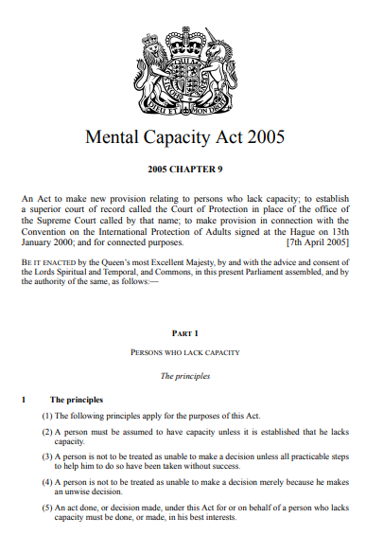
Is Mental Capacity Law Law…?
Focus on ‘mental capacity law’ means a focus on guardianship laws.
“P” = Person deemed to lack capacity.
“D” = Decision-maker for P.
Of course mental capacity law is law in the sense that we have a duly-enacted statute to govern questions concerning capacity and decision-making regarding property and affairs and health and welfare!
Centre for Health, Law, and Society

Slide 7

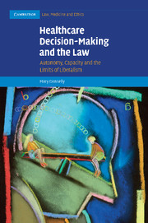
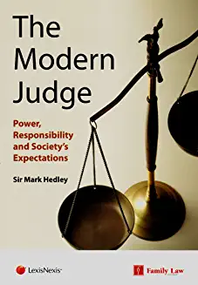
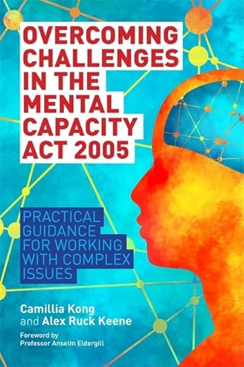
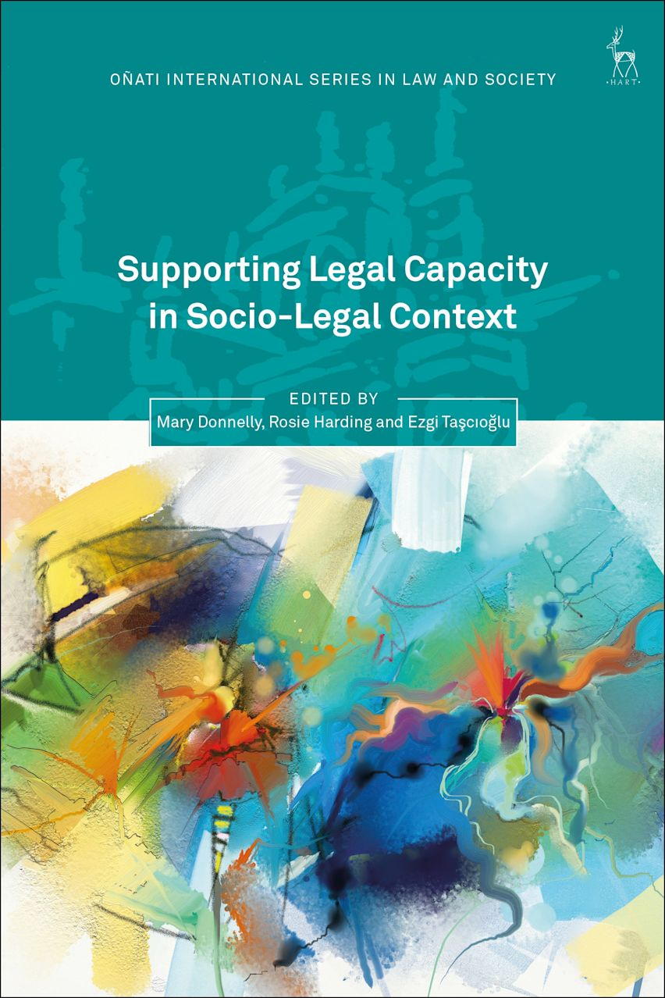
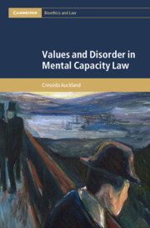
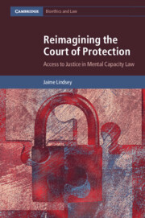
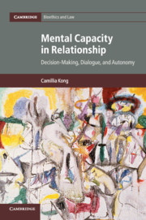
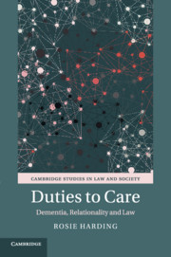


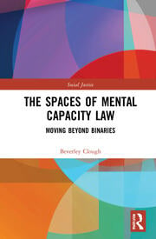
Centre for Health, Law, and Society

Slide 8
Is mental capacity law law…?
My practical focus in the talk is on judges’ application of the best interests standard
This standard circumscribes decision-making in England and Wales where a person is deemed to lack capacity
In mental capacity adjudication, are judges applying distinctly legal skill, and making a legal determination?
Asking ‘is mental capacity law law?’ allows us to:
  Advance critical discourses on mental capacity adjudication;
  Consider more widely the judicial role, and the meaning and operation of ‘law’ itself.
Centre for Health, Law, and Society

Slide 9
Structure
Brief overview of mental capacity law in England and Wales
Discussion of the ideas of law and legal adjudication
Three hints (‘warning bells’) about mental capacity law as an outlier area
Three radical challenges to mental capacity law as law
Some critical reflections
Four concluding questions
Centre for Health, Law, and Society

Slide 10
Part 2
Brief Overview of Mental Capacity Law in England and Wales
Centre for Health, Law, and Society

Slide 11
The development of contemporary mental capacity law
Historical origins in an ancient jurisdiction
Contemporary mental capacity law is a product of common law and statutory developments across about 40 years
Parens patriae jurisdiction replaced by statutory governance under Mental Health Acts 1959 and 1983
‘Gap’ for health and welfare: addressed through common law developments starting with Re F (Mental Patient: Sterilisation) [1990] 2 AC 112
These ran in parallel with developments leading to Mental Capacity Act 2005
Centre for Health, Law, and Society

Slide 12
The Mental Capacity Act 2005
Principles-based legislation: s. 1
Functional and diagnostic tests for (in)capacity: ss. 3 and 2:
  Can person understand, retain, and use/weigh information, and communicate decision?
  If not, is this “because of an impairment of, or a disturbance in the functioning of, the mind or brain”?
In line with the sort of analysis advanced in this paper, see:
  Binesh Hass, ‘Reasonableness in Capacity Law,’ (2023) Modern Law Review 86:6, 1447-1471;
  Binesh Hass, ‘The Values and Rules of Capacity Assessments,’ (2022) Journal of Medical Ethics 48, 816-820
Centre for Health, Law, and Society

Slide 13
The Mental Capacity Act 2005
Where a person is deemed to lack capacity, decisions are bound up in the best interests standard: s. 4:
  A non-exhaustive, non-ordinally-ranked ‘checklist’ of factors that D should take into account when determining P’s best interests.
  These include P’s wishes and feelings, and beliefs and values.
  But it is not about seeking to find and honour the decision that P would make, even should that be perfectly discernible.
  D must “consider all the relevant circumstances”, which include both circumstances “of which [D] is aware” and those “which it would be reasonable to regard as relevant.”
Centre for Health, Law, and Society

Slide 14
Part 3
The Ideas of Law, Legal Adjudication, and Judicial Discretion
Centre for Health, Law, and Society

Slide 15
A minimal characterisation of law to aid analysis
Consider Joseph Raz’s approach to providing a narrow/ formalist account of the rule of law:
  “[I]n the final analysis, the doctrine rests on its basic idea that the law should be capable of providing effective guidance.”
  “[I]f the law is to be obeyed it must be capable of guiding the behaviour of its subjects. It must be such that they can find out what it is and act on it.”
Joseph Raz, ‘The Rule of Law and its Virtue,’ in The Authority of Law: Essays on law and morality, (Clarendon Press, 1979), pp. 218 and 214 (emphasis in original)
Centre for Health, Law, and Society

Slide 16
Common law judging: applying and making law
Judges’ role allows for judicial law-making function:
  Vagueness/open-texture in language: HLA Hart, The Concept of Law, 2nd edn, (Oxford University Press, 1994);
  Changed situations, such as:
    New technologies or techniques: R (Quintavalle) v Secretary of State for Health [2003] UKHL 13;
    Erasure of anachronistic common law fictions: R v R [1991] UKHL 12;
    Change in the collective gravity of aggregated individual legal norms: Donoghue v Stevenson [1932] AC 562.
  ‘Boundary problems’ on e.g. ‘legal’ versus ‘political’.
All well recognised, and subject to varying frames of analysis
Centre for Health, Law, and Society

Slide 17
Part 4
Adjudication, Judicial Discretion, and the Court of Protection: Three Warning Bells…
Centre for Health, Law, and Society

Slide 18
A warning bell from legal theory
“Consider a normative system containing only rules instituting tribunals and regulating their operation. When a dispute is referred to a tribunal it will authoritatively be settled by its decision, for the system includes a rule to that effect. It contains a rule making it obligatory to observe the decisions of the courts and providing for their enforcement by a police force created for this purpose only. In such a system the courts can settle any dispute in any way they like. There are no legislated, customary, or any other standards which they have to apply. Nor do they have to follow their own precedents.”
Joseph Raz, ‘The Institutional Nature of Law,’ in The Authority of Law, pp. 111-112
Centre for Health, Law, and Society

Slide 19
A warning bell from legal theory (cont.)
“The courts of this peculiar system are not entitled to decide in an arbitrary way. They are instructed by a rule of the system to make that decision which seems to them the best in the circumstances, taking account of all the considerations which seem to them relevant. Since the courts have to act on reasons and reasons are general, we could expect some regularity in the decisions of the courts. The same judge hearing two very similar cases on the same day is likely to reach the same decision in both. But cases will be heard by many different judges and judges may change their mind as well as forget complex and intricate arguments, etc.”
Joseph Raz, ‘The Institutional Nature of Law,’ in The Authority of Law, pp. 111-112
Centre for Health, Law, and Society

Slide 20
A warning bell from legal theory (cont.)
“Consequently, the decisions of the courts over a period of time are unlikely to reflect any consistent line on any one issue. The degree of regularity will depend on contingent factors such as the number of judges, the degree of uniformity of their social background, etc.”
“It is unlikely that such a system has ever existed or will ever exist.”
Joseph Raz, ‘The Institutional Nature of Law,’ in The Authority of Law, pp. 111-112
Centre for Health, Law, and Society

Slide 21
A warning bell from the early case law
“[I]f the law requires the decision-maker to consider whether a certain course is ‘in the best interests’ of the patient, the skill and experience of the judge will carry him only so far. They will help him to clear the ground by marshalling the considerations which are said to be relevant, eliminating errors of logic, and so on. But when the intellectual part of the task is complete and the decision-maker has to choose the factors which he will take into account, attach relevant weights to them and then strike a balance the judge is no better equipped, though no worse, than anyone else. In the end it is a matter of personal choice, dictated by his or her background, upbringing, education, convictions and temperament.”
Per Lord Mustill, Airedale NHS Trust v. Bland [1993] AC 789, 887
Centre for Health, Law, and Society

Slide 22
A warning bell from a retired judge’s call for scrutiny
“The discretionary powers of the modern judge are seen most vividly—and most controversially—in the areas of child welfare and the best interests of those unable to make their own decisions. The question is: are discretionary powers compatible with justice? In his seminal work The Rule of Law, the late Lord Bingham wrote: ‘Questions of legal right and liability should ordinarily be resolved by the application of the law not the exercise of discretion.’ […]”
Sir Mark Hedley, The Modern Judge: Power, Responsibility and Society’s Expectations, (Bristol: LexisNexis, 2016), p. 47
Centre for Health, Law, and Society

Slide 23
A warning bell from a retired judge’s call for scrutiny
“[Best interests] decisions when made administratively can be challenged in the Court of Protection but… such decisions made judicially are very difficult to challenge. Yet these decisions can have lifelong implications […]. […] Do these powers exist with our consent? Do judges in exercising them have (and deserve) that consent? The complexity of our society may mean that there are few serious alternatives to the existence and exercise of discretionary powers, but in a healthy democracy these questions should be raised and considered.”
Sir Mark Hedley, The Modern Judge: Power, Responsibility and Society’s Expectations, (Bristol: LexisNexis, 2016), pp. 68-69
Centre for Health, Law, and Society

Slide 24
Part 5
Law and Mental Capacity Law:
Three Radical Challenges
Centre for Health, Law, and Society

Slide 25
1. Radical fundamental disagreement
Is sufficient legal certainty not found in MCA jurisprudence given the:
  Principles enumerated in s.1; and
  ‘MCA-cultural principles’, especially ‘P-centricity’?
1. Clashes between the principles
2. Lady Hale’s statement in Aintree University Hospital NHS Foundation Trust v. James [2013] UKSC 67 that “The courts have been most reluctant to lay down general principles which might guide the decisions. Every patient, every case, is different and must be decided on its own facts.” (para 36)
3. Melding distinct ‘cultures’: property & affairs and health and welfare:
  Contrast the framings e.g. of Lewison J in Re P [2009] EWHC 163 (Ch) at [36] and Baker J in W v M & Ors [2011] EWHC 2443 (Fam) at [85]
Centre for Health, Law, and Society

Slide 26
2. Radical non-prescription
By design, the Act is not very prescriptive/determinative.
1. Lady Hale, Aintree, [23]: “The Act gives some limited guidance.”
2. Section 4 is a non-exhaustive, non-ordinally ranked checklist, little more than the prescription in Raz’s imagined non-court?:
  “The courts of this peculiar system are not entitled to decide in an arbitrary way. They are instructed by a rule of the system to make that decision which seems to them the best in the circumstances, taking account of all the considerations which seem to them relevant.”
3. And look at how best interests gets defined by reference to what it is not: see e.g. the Explanatory Notes to the Act at para 28.
Centre for Health, Law, and Society

Slide 27
3. Radical departure from the basics of common law judging
Judges do not follow ‘rules’ of statutory construction or common law reasoning:
“The task of the court is to apply the statutory provisions, paying close heed to the language of the statute. Nevertheless, as judges tread their way through this treacherous terrain, it is helpful to look sideways and see how the courts have applied those statutory provisions to other factual scenarios. This has nothing to do with either the doctrine of precedent or the principles of statutory interpretation. The purpose is simply to see how other judicial decisions have exposed the issues or attempted to reconcile the irreconcilable.”
Per Jackson LJ in RB v Brighton and Hove City Council [2014] EWCA Civ 561, at [40]
Centre for Health, Law, and Society

Slide 28
Part 6
Critical Reflections
Centre for Health, Law, and Society

Slide 29
Looking beyond the non-legal aspects…
Much mental capacity scholarship focuses on:
  Non-legal aspects of judicial decisions;
  Development of interpretative standards/frames;
  Systematised, or anyway clustered, points of topic focus;
  Critique against standards beyond those provided at law.
But what do we find if we search for the legal aspects of legal adjudication in mental capacity law…?
Centre for Health, Law, and Society

Slide 30
Mental capacity law as law…
A statute and superabundance of case law - but the law is scant.
As a normative system, it is neither exhaustive nor is it clear and predictable: the language of mental capacity law creates empty spaces, and where it speaks it is very open textured.
And it is not circumscribed by an exhaustive list of values, either:
  In a coherent or comprehensive list to direct judgment; or
  With some in-principle possibility of a singular, overarching political morality from which a ‘Herculean’ judge might draw to find the ‘right’ answer.
Centre for Health, Law, and Society

Slide 31
Raising questions about discretion and power
Under the Act, judges have very broad discretionary power.
It does not follow that it is arbitrary, but there are—at best—very limited legal constraints.
The framing and function of mental capacity adjudication radically differ from general understandings of what would be expected of the role of the judicial branch.
A role more akin to an executive or administrative one than a judicial-interpretative or even judicial-legislative one?
Centre for Health, Law, and Society

Slide 32
Part 7
Four Concluding Questions
Centre for Health, Law, and Society

Slide 33
1. If the ultimate determination that the Mental Capacity Act allows a judge to make, using standards based in wisdom rather than legal application, were placed in the hands of (say) a government minister or a professional carer or a doctor or an administrator within a local authority, would we be content with that?
2. If not, (why) should we be happy with it falling to judges?
Centre for Health, Law, and Society

Slide 34
Is there a paradox in affording special privilege to the expert and institutional (and thereby constitutional) position of judges under the MCA: namely that on the terms set by the Act, the more law-like a judicial decision might be, and the more given it is to the application of legal method, the worse it is?
And does all of this perhaps not speak so much to a problem with the idea of mental capacity law, but rather the idea of law-writ-large itself?
Centre for Health, Law, and Society

